Slide 1
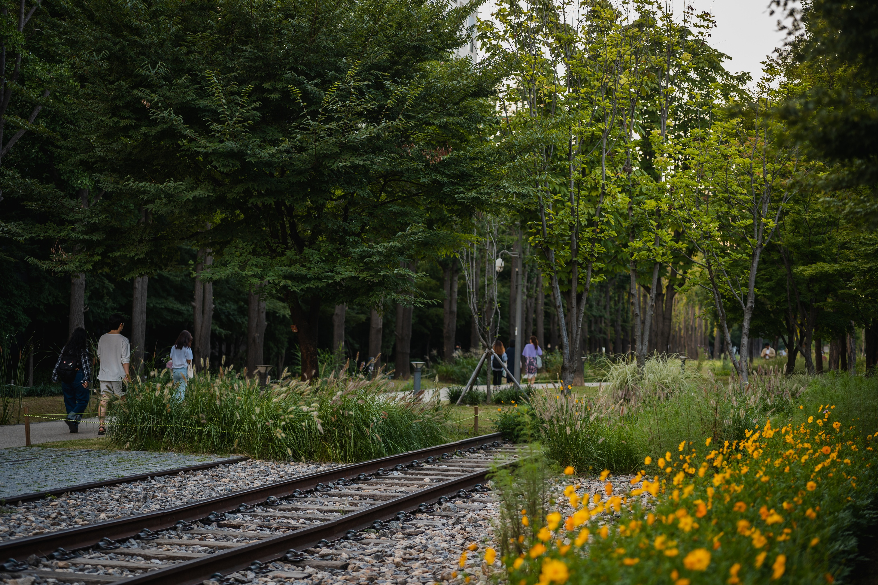
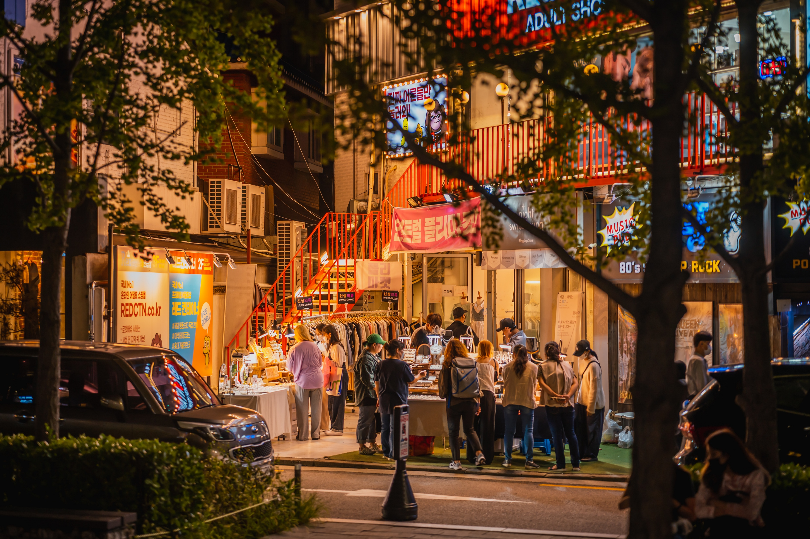
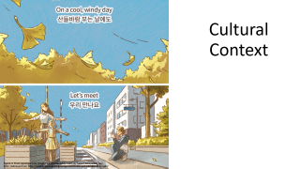
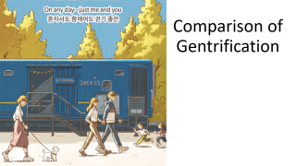
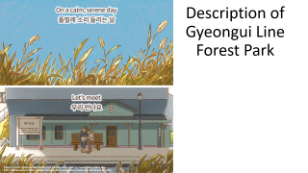
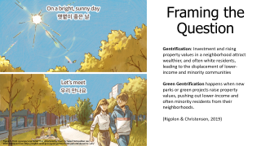
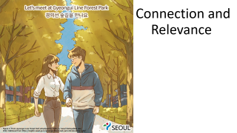
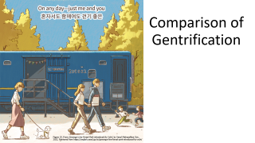


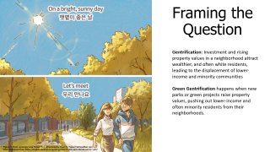

Gyeongui Line Forest Park
Figure 2. From Gyeongui Line Forest Park, by Seoul Metropolitan Gov, 2022. Retrieved from https://english.seoul.go.kr/gyeongui-line-forest-park/
Figure 1. From Gyeongui Line Forest Park, by Seoul Metropolitan Gov, 2022. Retrieved from https://english.seoul.go.kr/gyeongui-line-forest-park/
Notes:
Introduce Gyeongui (jong-jue) Line Forest Park as the case study.
Preview what will be covered:
Description of the park
Context
Evidence of gentrification and comparison
Connection to readings
relevance

Slide 2
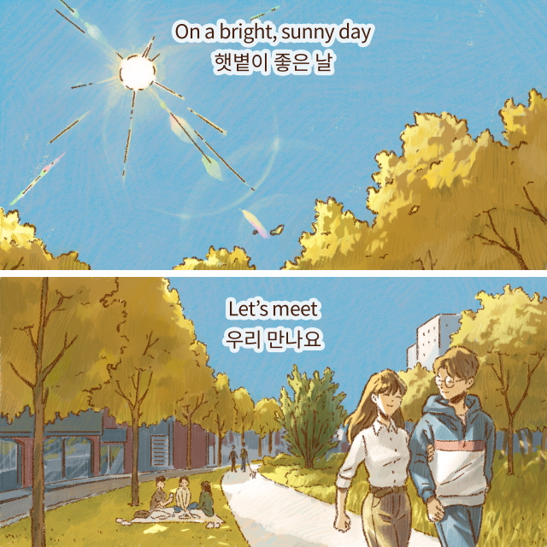
Framing the Question
Gentrification: Investment and rising property values in a neighborhood attract wealthier, and often white residents, leading to the displacement of lower-income and minority communities
Green Gentrification happens when new parks or green projects raise property values, pushing out lower-income and often minority residents from their neighborhoods.
(Rigolon & Christensen, 2019)
Figure 3. From Gyeongui Line Forest Park introduced by Yulri!, by Seoul Metropolitan Gov, 2022. Retrieved from https://english.seoul.go.kr/gyeongui-line-forest-park-introduced-by-yulri/
Notes:
Define terms
Green gentrification is a tricky subject because usually parks and green infrastructure is meant to serve a community that is already established but can often end up displacing those who it was meant to serve.

Slide 3
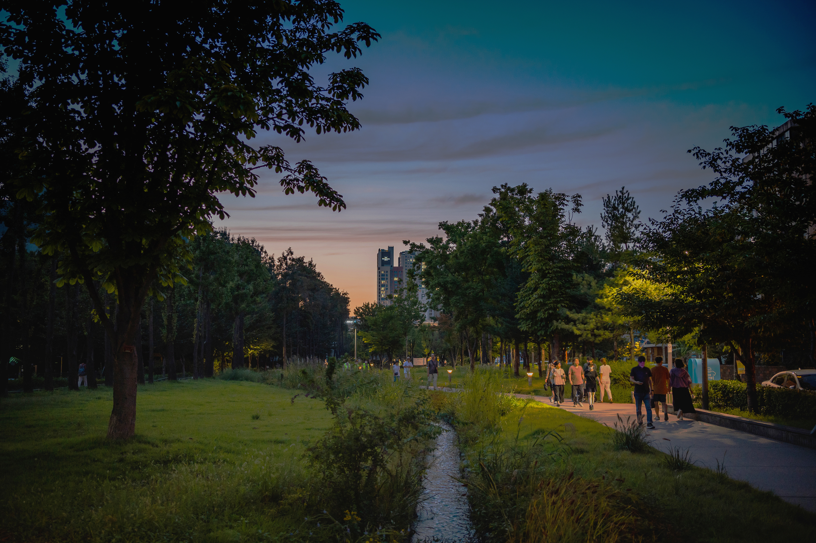
A question to ponder…
Figure 4. From Gyeongui Line Forest Park, by Seoul Metropolitan Gov, 2022. Retrieved from https://english.seoul.go.kr/gyeongui-line-forest-park/
Notes:
In what ways can urban planning policies proactively address the negative effects of gentrification associated with public park development?

Slide 4
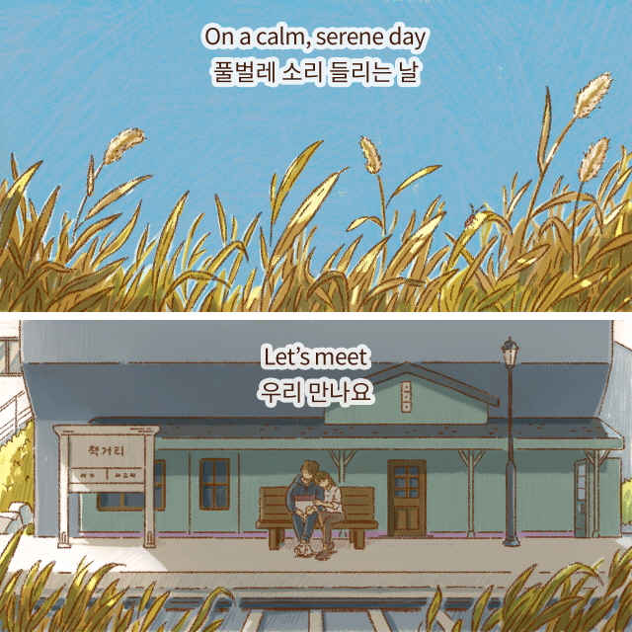
Description of Gyeongui Line
Forest Park
Figure 5. From Gyeongui Line Forest Park introduced by Yulri!, by Seoul Metropolitan Gov, 2022. Retrieved from https://english.seoul.go.kr/gyeongui-line-forest-park-introduced-by-yulri/
Notes:
Introduce section, mention quotes

Slide 5
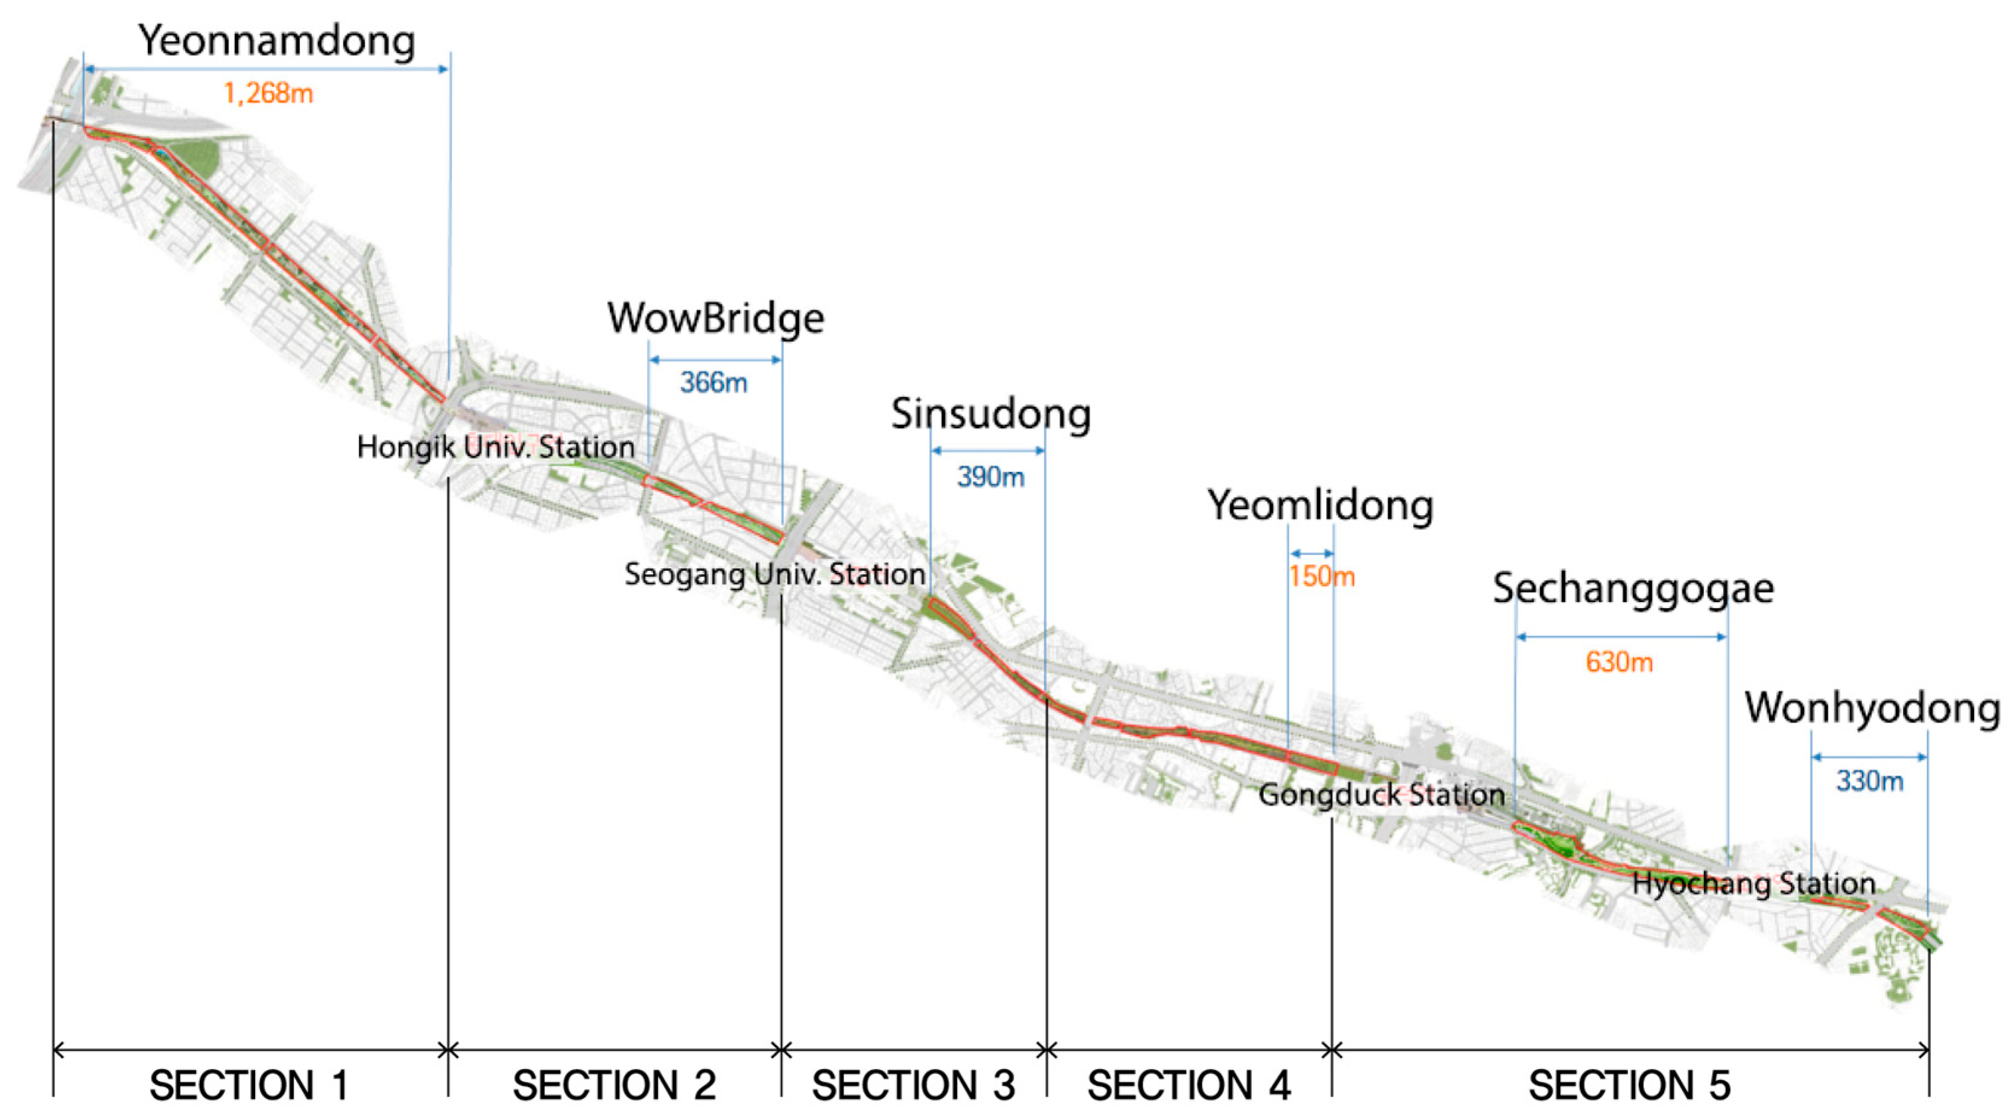
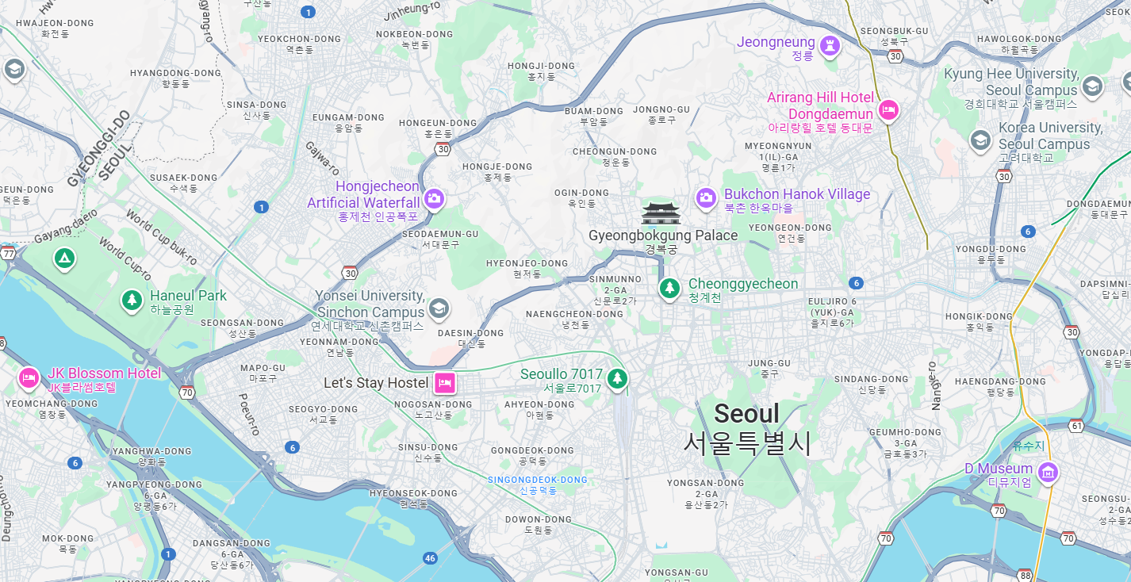
Figure 6. From A Case Study of Gyeongui Line Forest Park in Seoul, by Jisoo Sim, 2020. Retrieved from https://doi.org/10.3390/su12176722
Location: Mapo-gu and Yongsan-gu, Seoul, South Korea
Figure 7. From Google Earth, 2023.
Notes:
Gyeongui Line Forest Park is a linear urban park in western Seoul, South Korea, created along the former Gyeongui railway line. It stretches through neighborhoods such as Yeonnam-dong and extends toward areas near Hongik University in the Mapo District. The park weaves between dense residential and commercial blocks, serving as a green corridor that connects local streets, cafes, and transit stations.

Slide 6
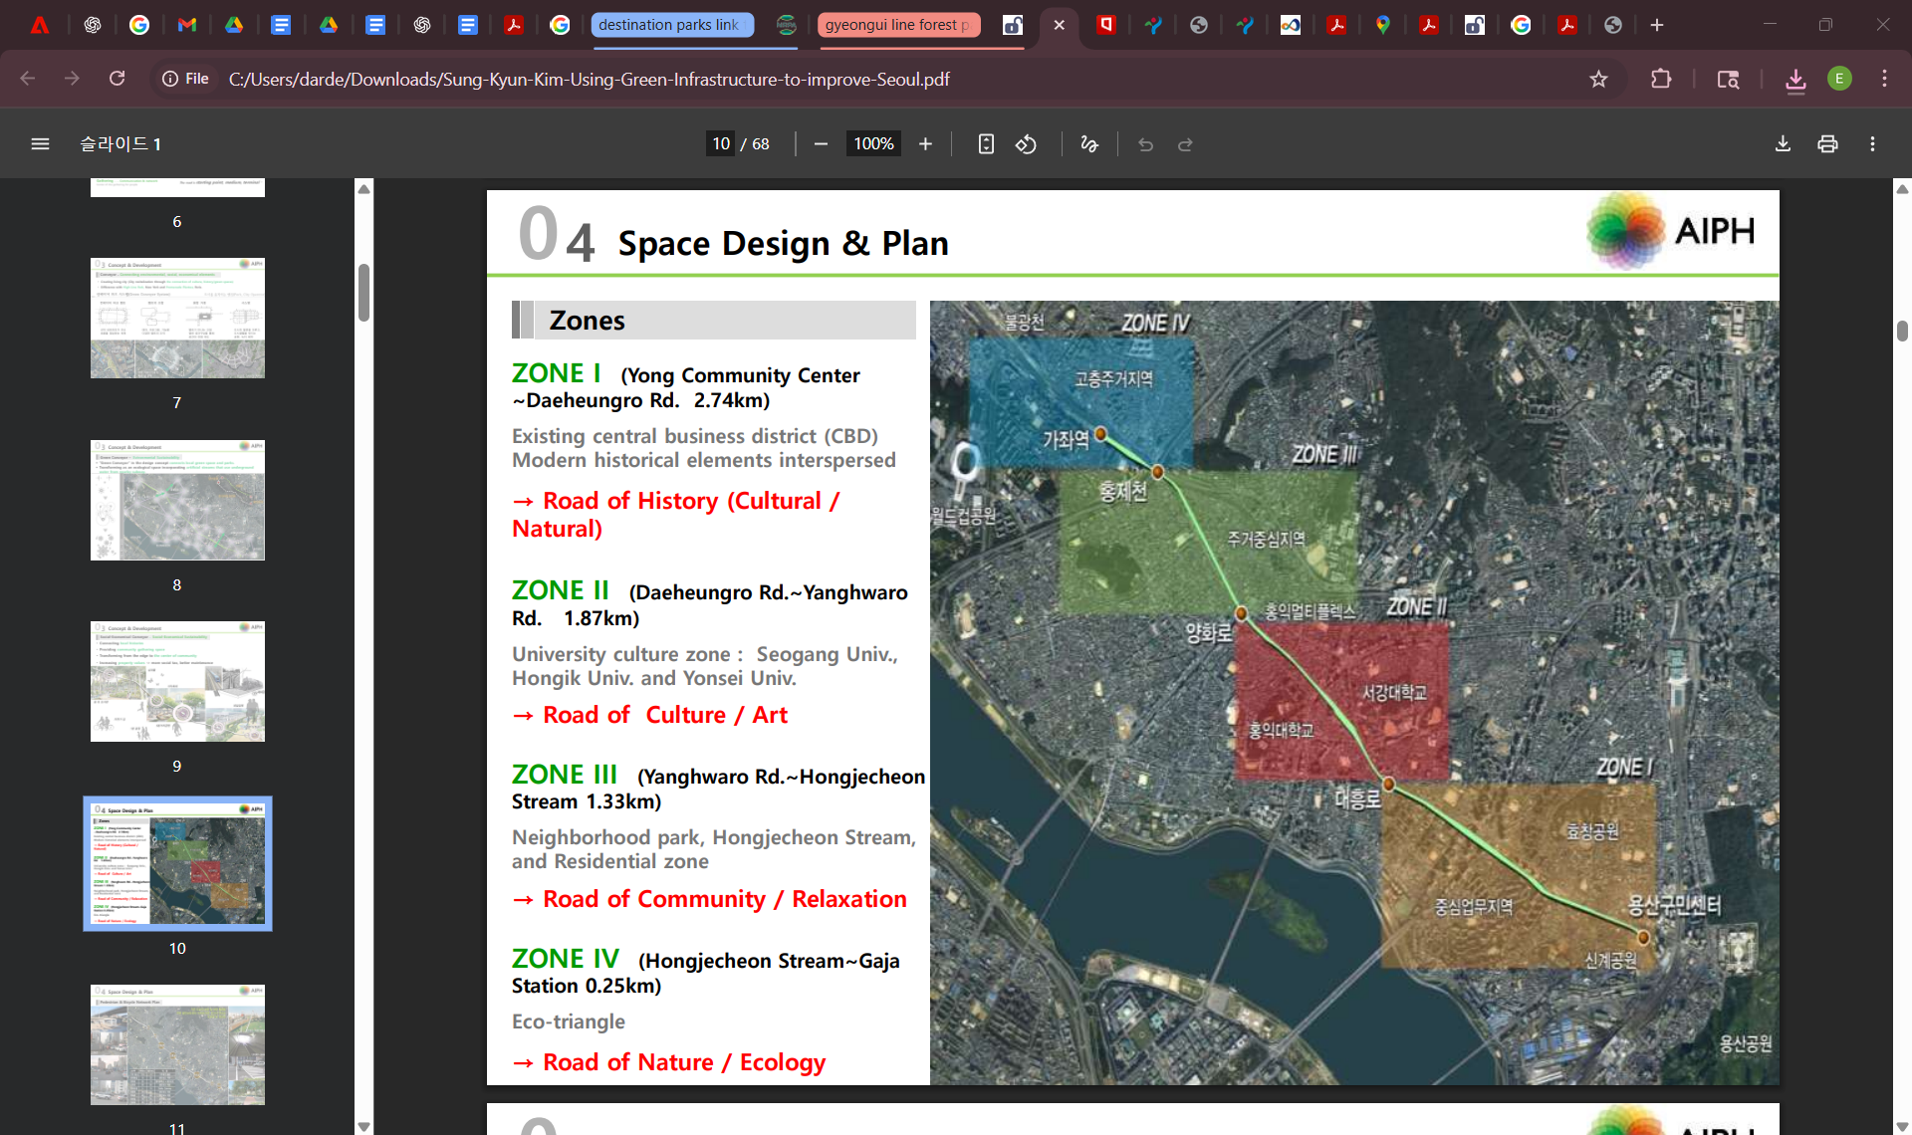
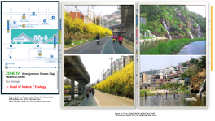
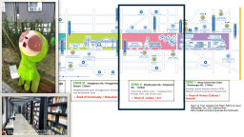
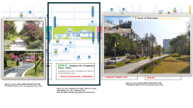
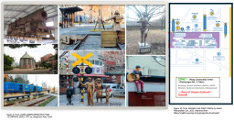




Design: 6.3-km linear park built on an old railway. Focus on walkability, greenery, social connection, and meeting individual neighborhood needs
Figure 8. From USING GREEN INFRASTRUCTURE
TO IMPROVE SEOUL CITY, by Sung-Kyun Kim, 2018.
Notes:
Designed as a mixed use (cargo and passenger) connector between north and south korea
Mostly served commuters in Seoul after north Korea split
Turned into a subway line underground
Cargo operations ceased in the city
10-60 meters wide
Vastly different in each neighborhood
Space designed to be appropriated
Huge neighborhood level contribution to each section to meet the needs of the residents
Used New York’s High Line and Chicago 606 rail as precedents

Slide 7
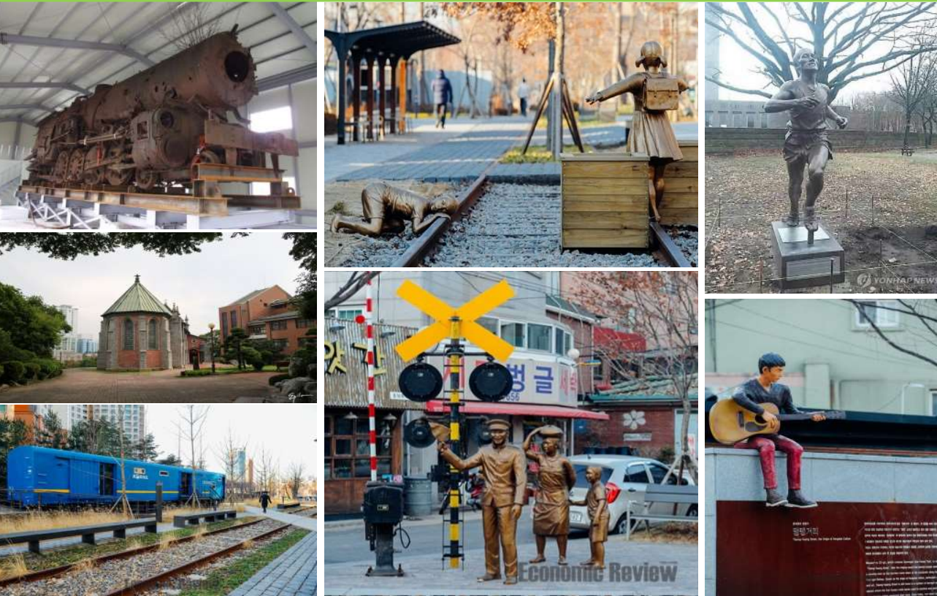
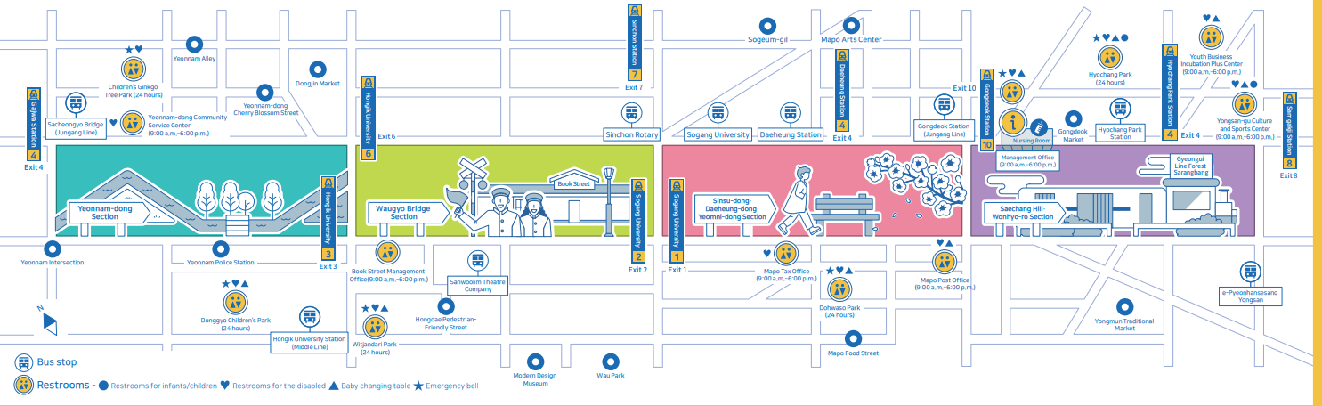
Figure 10. From Gyeongui Line Forest Park by by Seoul Metropolitan Gov, 2022. Retrieved from https://english.seoul.go.kr/gyeongui-line-forest-park/
Figure 9. From USING GREEN INFRASTRUCTURE
TO IMPROVE SEOUL CITY, by Sung-Kyun Kim, 2018.
Notes:
Gongdeok Section
Near Gongdeok Station, the park shifts toward a more infrastructural and commuter-focused character. Surrounded by office buildings and high-rise residential towers, this section offers shaded seating areas and landscaped strips that provide relief from the dense built environment. The atmosphere is calmer and less commercial than Yeonnam-dong, functioning primarily as a green corridor for daily transit and neighborhood recreation. Here, the park’s role as connective urban infrastructure becomes especially evident, linking transit nodes with surrounding communities.

Slide 8
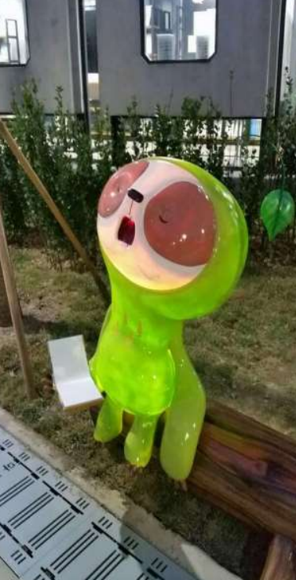
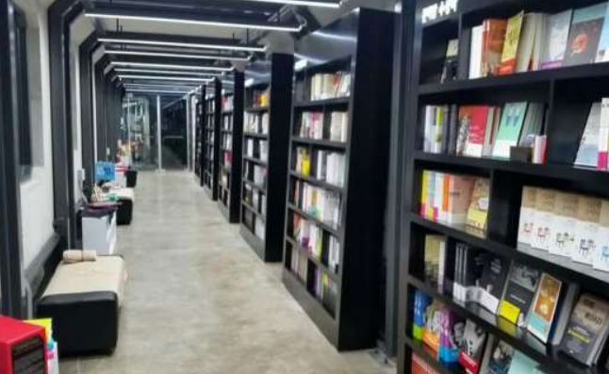
Figure 10. From Gyeongui Line Forest Park by by Seoul Metropolitan Gov, 2022. Retrieved from https://english.seoul.go.kr/gyeongui-line-forest-park/
Figure 11. From USING GREEN INFRASTRUCTURE
TO IMPROVE SEOUL CITY, by Sung-Kyun Kim, 2018.
Notes:
Hongdae (Hongik University) Section
Adjacent to Hongik University, this portion of the park reflects the creative and youthful identity of the Hongdae district. The space widens in places to accommodate performances, busking, and spontaneous gatherings tied to the area’s arts culture. Hardscape plazas mix with planted zones, allowing the park to function both as green infrastructure and as flexible event space. This section blurs the boundary between campus life, nightlife, and public open space, making it one of the most dynamic stretches of the corridor.

Slide 9
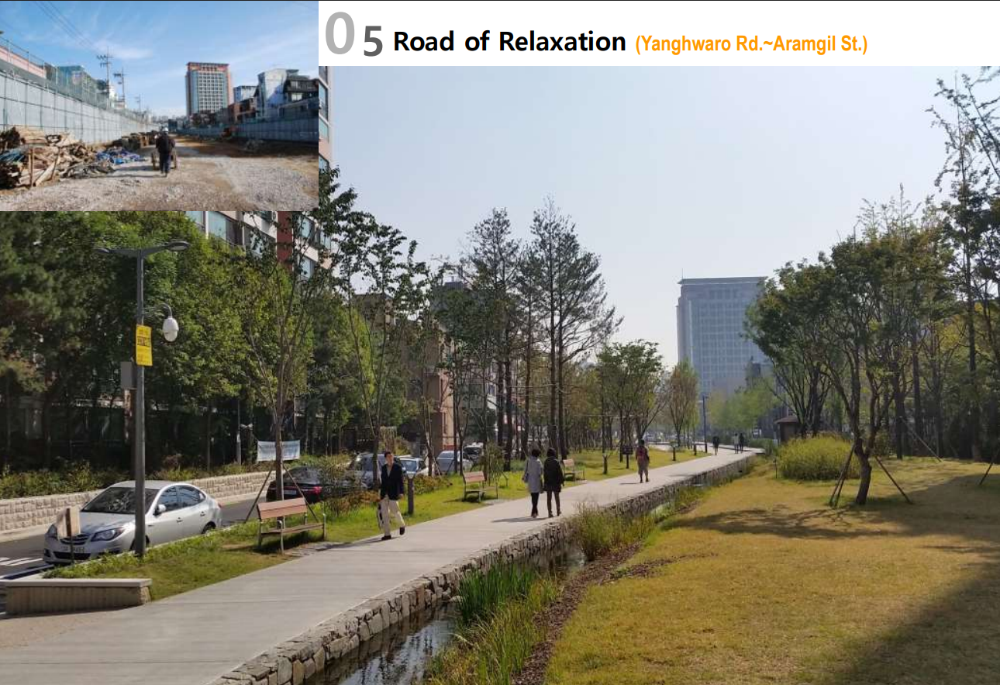
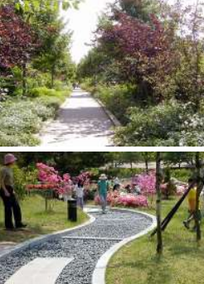
Figure 12. From USING GREEN INFRASTRUCTURE
TO IMPROVE SEOUL CITY, by Sung-Kyun Kim, 2018.
Figure 13. From USING GREEN INFRASTRUCTURE
TO IMPROVE SEOUL CITY, by Sung-Kyun Kim, 2018.
Figure 10. From Gyeongui Line Forest Park by by Seoul Metropolitan Gov, 2022. Retrieved from https://english.seoul.go.kr/gyeongui-line-forest-park/
Notes:
Yeonnam-dong Section
The Yeonnam-dong stretch of Gyeongui Line Forest Park is one of its most well-known and socially active segments, running through a dense residential and café-lined neighborhood in western Seoul. Built along the former Gyeongui railway corridor, it maintains a narrow, linear form with lawns, trees, and pedestrian paths closely integrated with surrounding storefronts. The park acts as an outdoor living room for the neighborhood, where daily routines, informal gatherings, and evening strolls overlap. Its human-scale edges and direct interface with small businesses give it an intimate, community-oriented atmosphere.

Slide 10
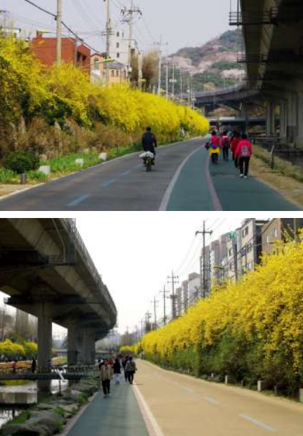
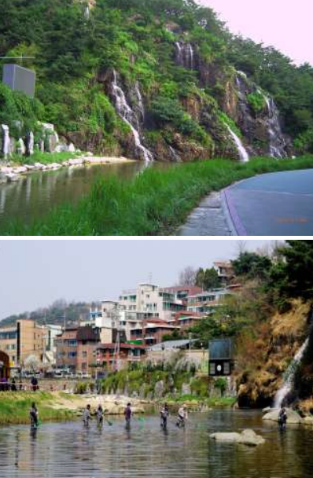
Figure 10. From Gyeongui Line Forest Park by by Seoul Metropolitan Gov, 2022. Retrieved from https://english.seoul.go.kr/gyeongui-line-forest-park/
Figure 14. From USING GREEN INFRASTRUCTURE
TO IMPROVE SEOUL CITY, by Sung-Kyun Kim, 2018.
Notes:
Sinchon Section
The Sinchon segment connects academic and commercial districts, serving as a transitional landscape between university areas and more residential neighborhoods. Its design emphasizes walking paths and vegetated buffers that soften adjacent traffic corridors while maintaining the linear continuity of the former rail line. Compared to Hongdae, activity here is more movement-oriented, with pedestrians and cyclists using the corridor as a through-route. The park provides much-needed greenery within a highly urbanized context, reinforcing connectivity across district boundaries.

Slide 11
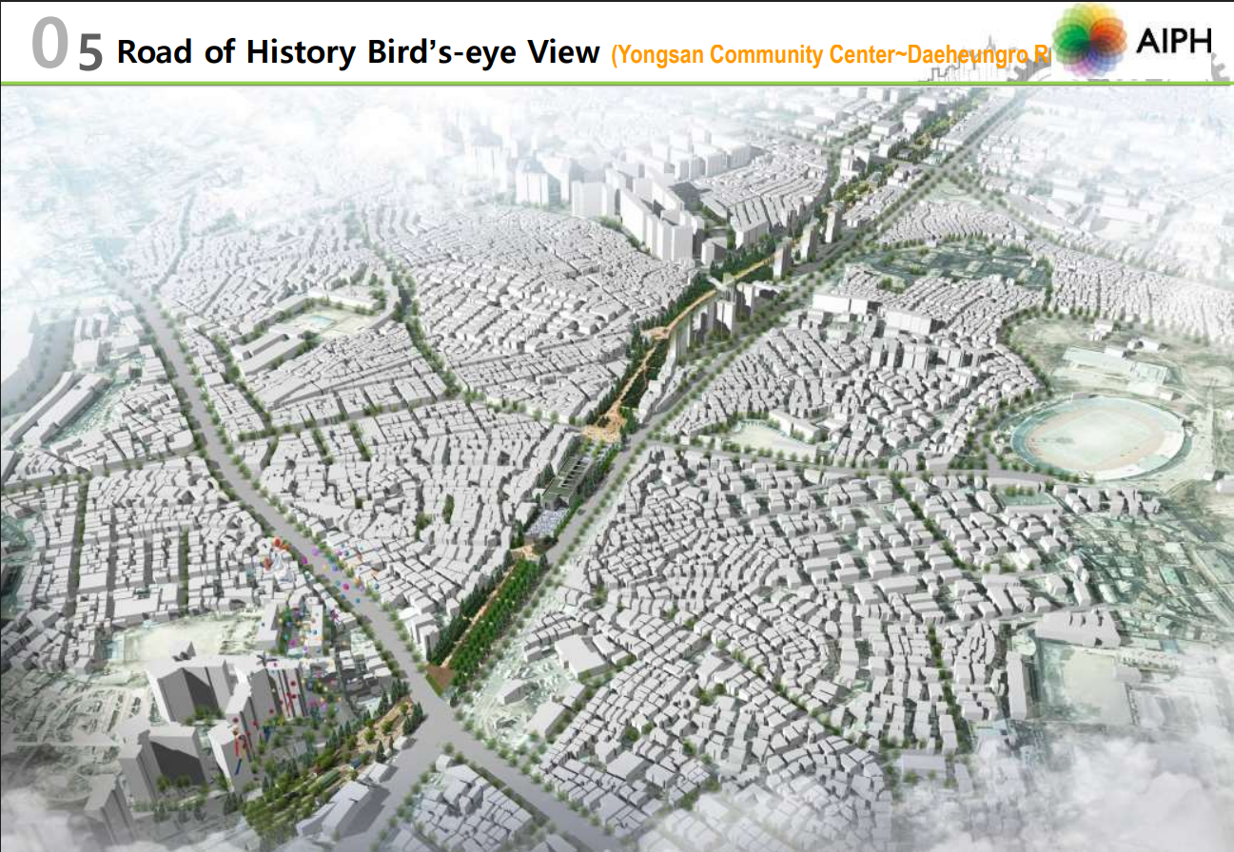
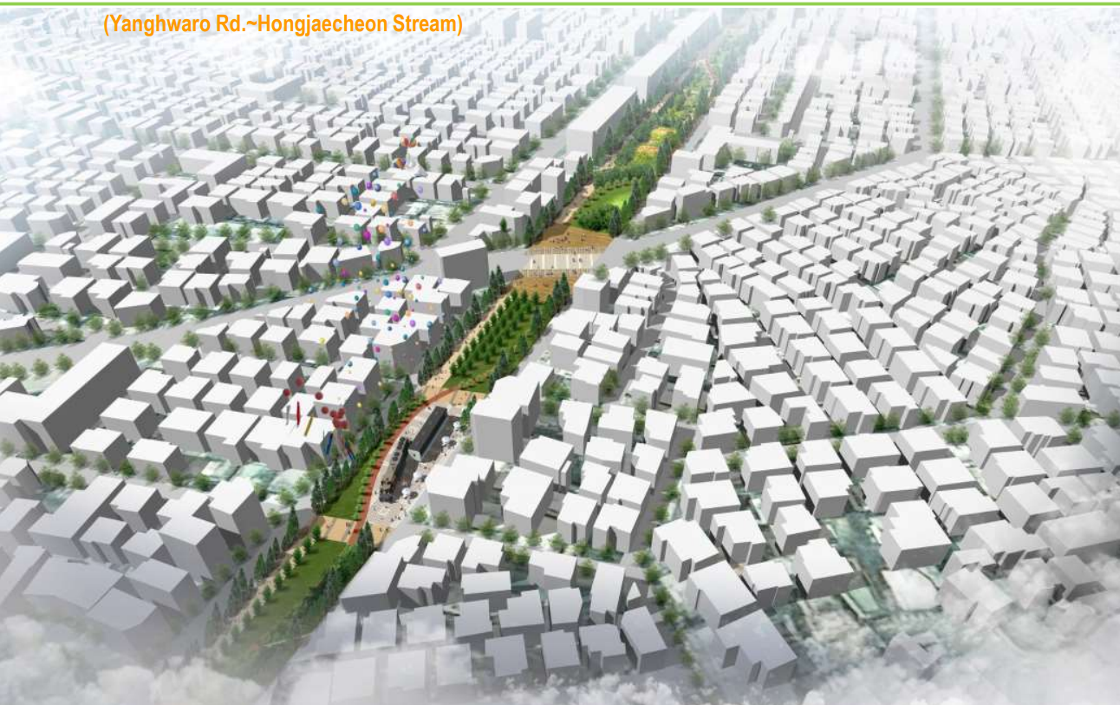
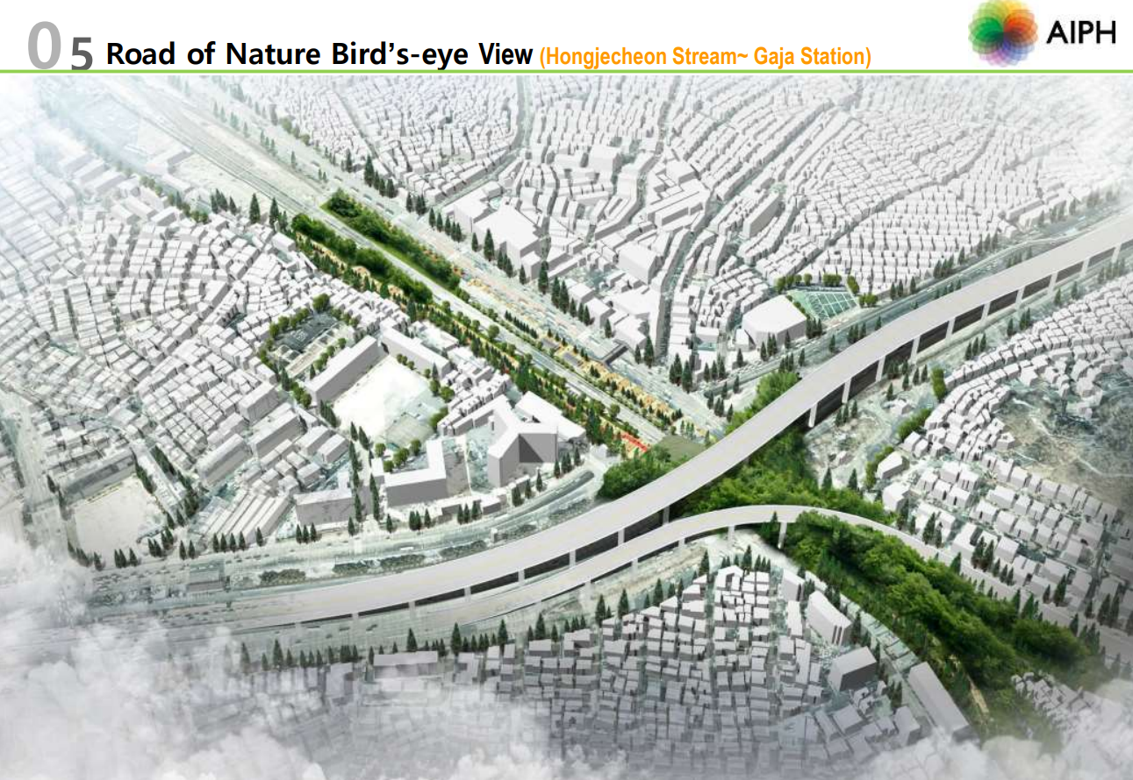
Figure 15-17. From USING GREEN INFRASTRUCTURE
TO IMPROVE SEOUL CITY, by Sung-Kyun Kim, 2018.

Slide 12
Designers/Planners:
  Seoul Metropolitan Government's Urban Planning and Design Division.
  Korea Rail Network Authority.
And others
¯\_(ツ)_/¯
Notes:
Lack of visuals due to lack of information
Local civic groups (community programming).
Collaboration with hundreds of local designers and artists who are not always credited.

Slide 13
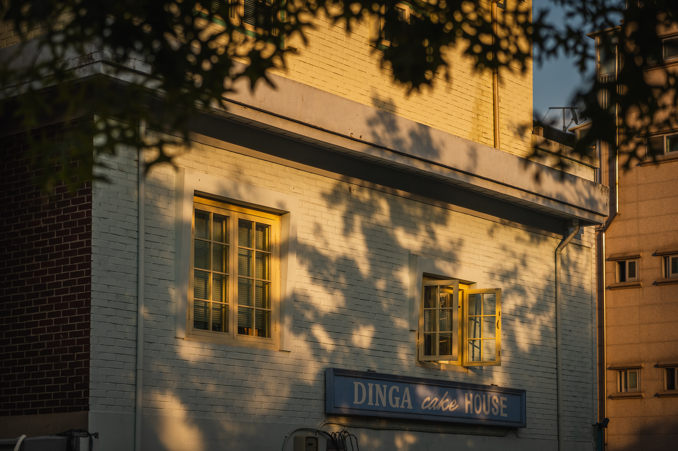
Rail construction begins
All rail sections opened
Suspension of rail due to Korean War
Operation resumes only from Seoul to Munsan
underground subway opens
Above ground train suspended during park development
Forest park is completed; commuter train resumes; above ground train is closed permanently
Commencement of park creation
2016
2009
2009
1953
1904-1951
Figure __ From Gyeongui Line Forest Park, by Seoul Metropolitan Gov, 2022. Retrieved from https://english.seoul.go.kr/gyeongui-line-forest-park/

Slide 14
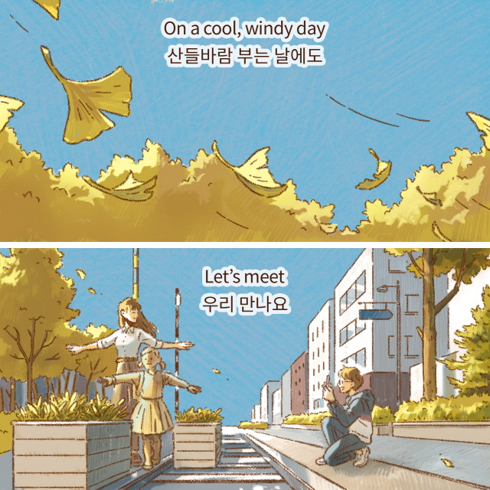
Cultural Context
Figure 3. From Gyeongui Line Forest Park introduced by Yulri!, by Seoul Metropolitan Gov, 2022. Retrieved from https://english.seoul.go.kr/gyeongui-line-forest-park-introduced-by-yulri/

Slide 15
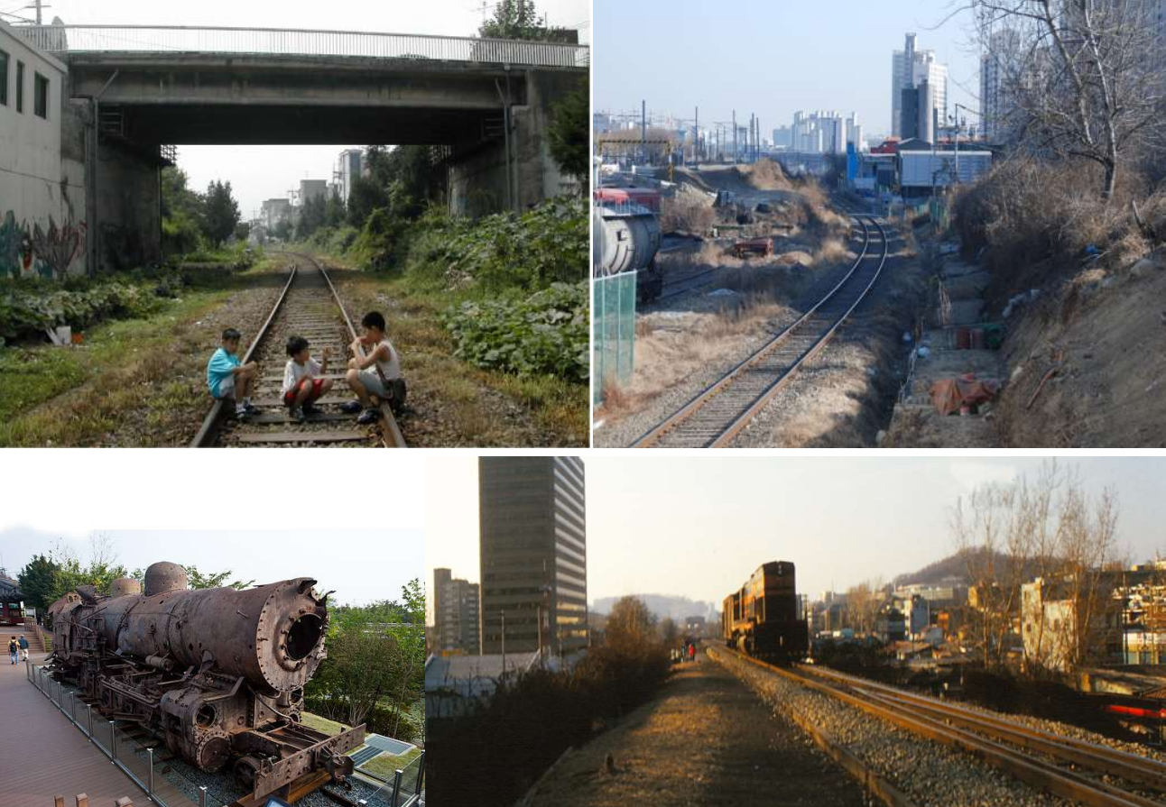
The Gyeongui Line Forest Park was conceived in the late 2000s as part of Seoul’s urban regeneration strategy.
The main goals were:
  Reclaiming disused railway land for public use.
  Reducing heat and air pollution.
  Increasing pedestrian space and quality of life in dense neighborhoods.
how you might expect a lack of consideration around gentrification to impact the community surrounding a quickly developed, large scale urban project?
Figure 18. From USING GREEN INFRASTRUCTURE
TO IMPROVE SEOUL CITY, by Sung-Kyun Kim, 2018.
Notes:
Gentrification was not a major planning concern at the outset.
At that time, green gentrification was not yet a major part of South Korean planning discourse.
Korean planning agencies emphasized beautification, sustainability, and tourism, not social equity or displacement.
Most Korean urban regeneration projects focused on physical and environmental renewal, not socioeconomic protection.
There is no record of policies such as rent stabilization, community benefit agreements, or affordable housing protections being tied to the Gyeongui Line project.
The surrounding Yeonnam-dong neighborhood was already experiencing small-scale gentrification before the park opened (due to its location near Hongdae University and a rising creative class).
The park accelerated and concentrated these trends by boosting the area’s desirability and visibility

Slide 16
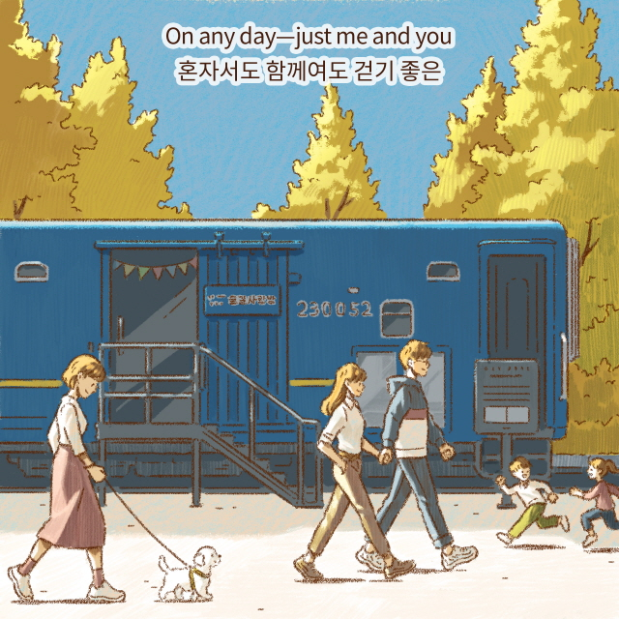
Comparison of Gentrification
Figure 19. From Gyeongui Line Forest Park introduced by Yulri!, by Seoul Metropolitan Gov, 2022. Retrieved from https://english.seoul.go.kr/gyeongui-line-forest-park-introduced-by-yulri/
Notes:
Keep in mind that gentrification was not a consideration when designing the Gyeongui line park

Slide 17
2003 – Public Support and Rezoning
The City of New York formally backs the plan to transform the structure into a linear park.
Property investors begin buying in anticipation; home values start to rise modestly as expectations grow for redevelopment in West Chelsea.
2006 – Construction Begins
As work begins on Section 1 (Gansevoort St → 20th St), nearby condo development surges.
2009 – Section 1 Opens
The opening of the first section brings global attention and immediate market response.
Properties directly adjacent to the park now command the highest per-square-foot prices in Manhattan, solidifying the “High Line premium.”
2011 – Section 2 Opens (20th St → 30th St)
Continued appreciation, with West Chelsea’s median resale price nearly doubling from 2003 to 2011
Developers rush to market luxury condos and art-district lofts leveraging the park’s reputation.
2014 – Section 3 Opens (Hudson Yards Connection)
Prices continue to rise but at a slower rate as the neighborhood fully transitions into a luxury district.
Around +100%
+100%
+24-32%
+18-24%
Notes:
How do the different economic and housing systems influence gentrification?

Slide 18
Rail construction begins
All rail sections opened
Suspension of rail due to Korean War
Operation resumes only from Seoul to Munsan
underground subway opens
Above ground train suspended during park development
Forest park is completed; commuter train resumes; above ground train is closed permanently
Commencement of park creation
2016
-5%*
5-15%
2009
2009
1953
1904-1951
* = 10% total, some fell from 15 to 10%, some rose from 5 to 10% (approximately)
Notes:
Spatial data show land and housing prices rose most within 300–500 m of the park. (walking distance)
Yeonnam-dong segment saw strongest change; Sinsu-dong least.
New cafés, boutiques, and tourism replaced older small businesses.
Maximum impact up to 800 meters
“the negative effect of the rail site on residential property values rapidly turned positive after the city government announced the park procurement plan in November 2006. Specifically, apartments that were 100 m closer to Gyeongui Line Park saw an approximately 15% higher market value on average than those located further away, controlling for other price factors. ”
Big takeaways: is a park at your doorstep that you helped design worth 10% more in housing costs? Why does speculative real estate impact gentrification more than the built environment. How responsible for our messaging should we as urban designers be. This measures gentrification, not displacement.

Slide 19

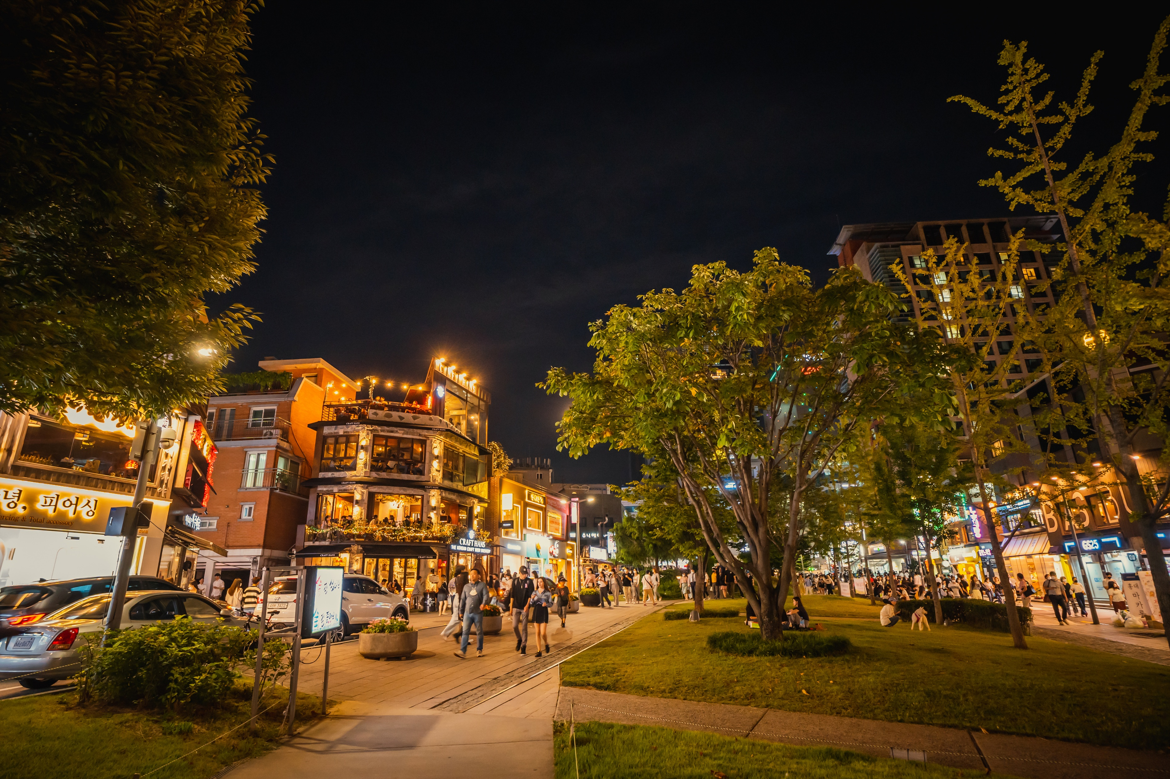
Why the difference?
A. Urban density and housing ownership structure
B. Park function and location
D. Government planning goals
E. Cultural factors
Figure 1. From Gyeongui Line Forest Park, by Seoul Metropolitan Gov, 2022. Retrieved from https://english.seoul.go.kr/gyeongui-line-forest-park/
Figure 1. From Gyeongui Line Forest Park, by Seoul Metropolitan Gov, 2022. Retrieved from https://english.seoul.go.kr/gyeongui-line-forest-park/
Notes:
A. Urban density and housing ownership structure
Seoul’s housing market is dominated by apartment complexes and the jeonse (deposit lease) system, which buffers rapid rent hikes in some cases.
In contrast, New York and Chicago have more fluid rental markets and private property speculation around new amenities.
B. Park function and location – high value of highline area, low value of Gyeongui line area
Gyeongui Line is a 6.3-km neighborhood park, primarily serving local residents, whereas the High Line is a global tourist destination.
The High Line catalyzed large-scale commercial and real estate redevelopment — Gyeongui Line mostly reshaped small-scale retail and lifestyle patterns.
D. Government planning goals
The Seoul Metropolitan Government’s intention was urban regeneration, not economic stimulation or real estate branding.
There was no major rezoning or public-private redevelopment tied to the park — limiting large-scale speculative investment.
Design intentions
E. Cultural factors
Korean urban culture places strong emphasis on publicness and shared green space.
There is less expectation that parks should drive private development profits (though that is changing).
As a result, the park’s success was measured more in use and livability than in property revenue.
Key takeaway: Gentrification is driven by expectations and speculative real estate, not necessarily built environment

Slide 20
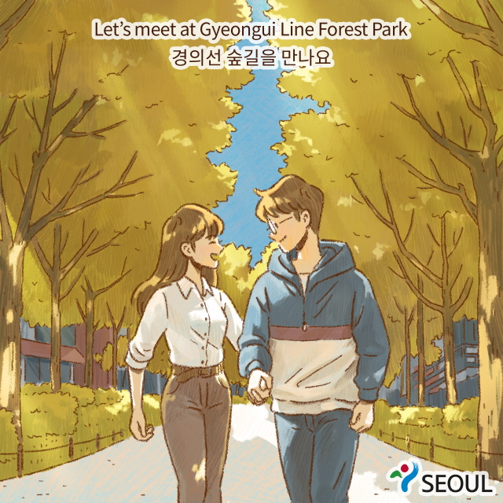
Connection and Relevance
Figure 3. From Gyeongui Line Forest Park introduced by Yulri!, by Seoul Metropolitan Gov, 2022. Retrieved from https://english.seoul.go.kr/gyeongui-line-forest-park-introduced-by-yulri/

Slide 21
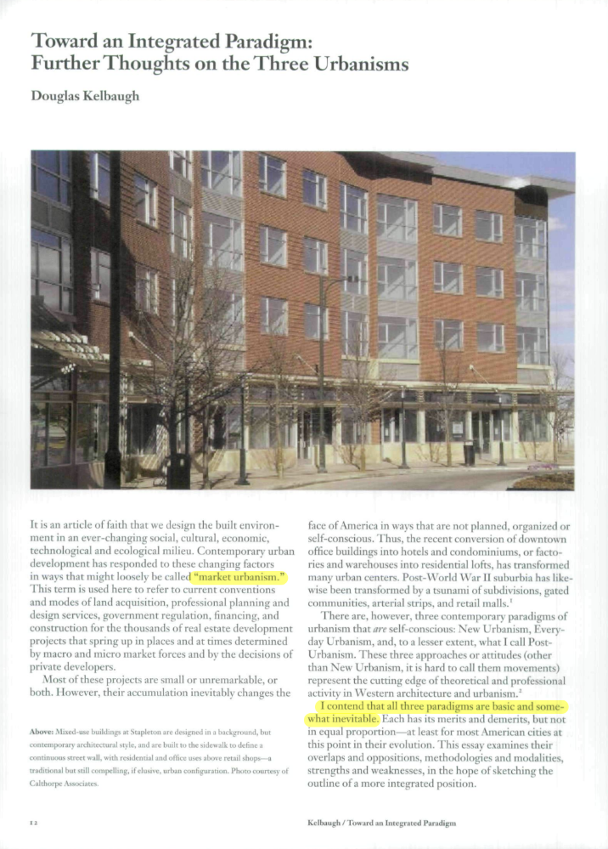
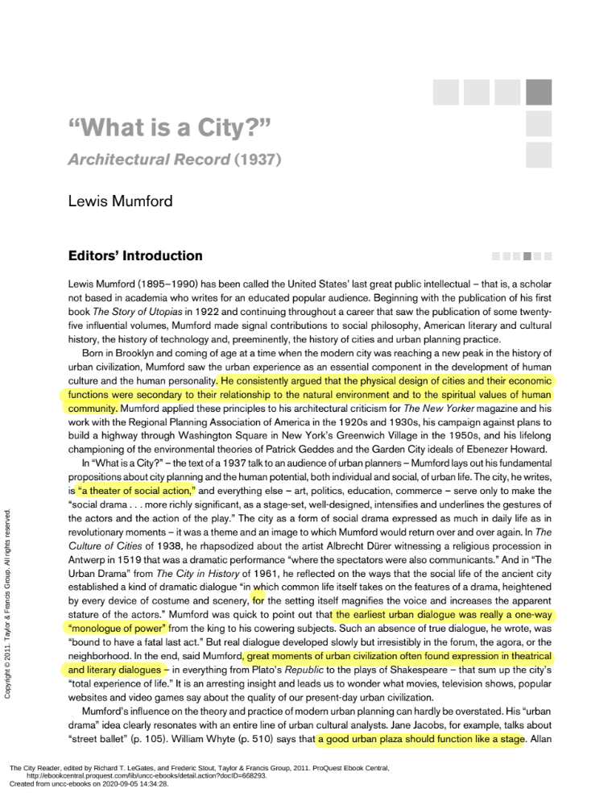
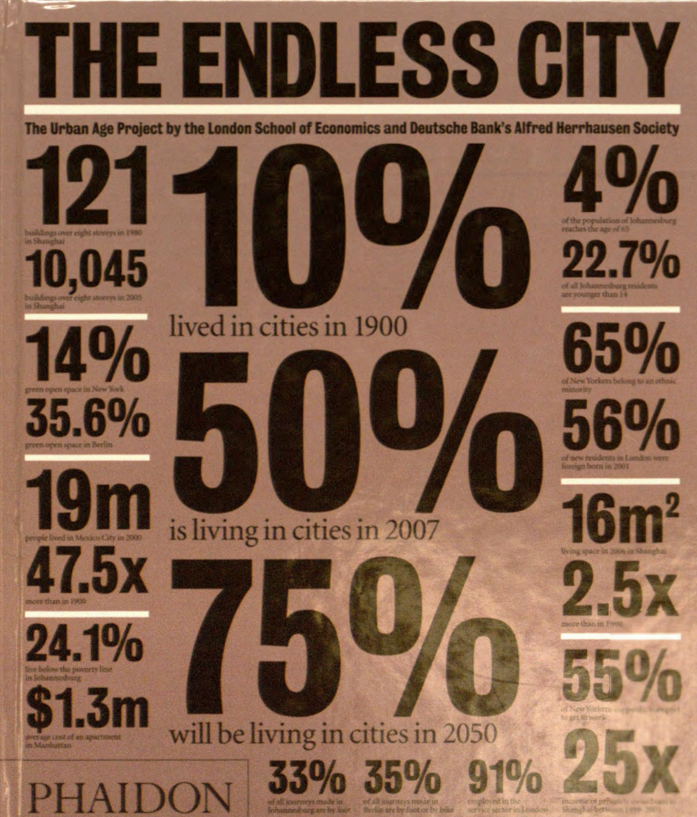
Notes:
Kelbaugh – post urbanism (highline) vs everyday urbanism
Mumfords argument that the physical design of cities and their economic functions are secondary to their relationship with the natural environment and to their spiritual values of human community; and that the city industry and markets must be subservient to its social needs
Penalosa – discussion about how the most sustainable city would be one which is conducive to human happiness, socialization, and health.

Slide 22

Did you ponder?
Relevance
Figure 4. From Gyeongui Line Forest Park, by Seoul Metropolitan Gov, 2022. Retrieved from https://english.seoul.go.kr/gyeongui-line-forest-park/
Notes:
In what ways can urban planning policies proactively address the negative effects of gentrification associated with public park development?
Shows that green gentrification is a global issue, not just Western.
Raises policy questions about how we think about equity, housing, and environmental justice.
What policies or design approaches could prevent gentrification? Most studies focus on establishing if it exists from a case study, or to what degree. Others focus on what did not work in preventing it, or are overly vague with their recommendations such as “community engagement.”

Slide 23
All Sources
https://parks.seoul.go.kr/maps/gyeongui/gyeongui_map_ENG.pdf
https://www.mdpi.com/2071-1050/12/17/6722
https://journals.sagepub.com/doi/10.1177/0042098019849380
https://www.acuitykp.com/blog/koreas-jeonse-housing-rental-system/
https://cm.asiae.co.kr/en/article/2021062108042012775?utm_source=chatgpt.com
https://www.mdpi.com/2071-1050/9/2/231
https://www.nrpa.org/parks-recreation-magazine/2019/december/greening-without-gentrification/
https://www.sciencedirect.com/science/article/pii/S019739751530254X
https://streeteasy.com/blog/changing-grid-high-line/
References
Jung, E. (2016). The impact of the Gyeongui Line Park project on housing prices in Seoul, Korea. Urban Studies, 53(11), 2297–2314. https://doi.org/10.1177/0042098015612540
Kwon, Y., Joo, S., Han, S., & Park, C. (2017). Mapping the Distribution Pattern of Gentrification near Urban Parks in the Case of Gyeongui Line Forest Park, Seoul, Korea. Sustainability, 9(2), 231. https://doi.org/10.3390/su9020231
Rigolon, A., & Christensen, J. (2019, November). Greening without gentrification: Learning from parks-related anti-displacement strategies nationwide. Parks & Recreation, 54(12). https://www.nrpa.org/parks-recreation-magazine/2019/december/greening-without-gentrification/
Seoul Metropolitan Government. (n.d.). Gyeongui Line Forest Park introduced by Yulri. https://english.seoul.go.kr/gyeongui-line-forest-park-introduced-by-yulri/
Seoul Metropolitan Government. (2022, September). Gyeongui Line Forest Park. https://english.seoul.go.kr/gyeongui-line-forest-park/
Seoul Metropolitan Government. (n.d.). Gyeongui Line Forest Park map [PDF]. Seoul Parks. https://parks.seoul.go.kr/maps/gyeongui/gyeongui_map_ENG.pdf
Sim, J. (2020). Seeing Impacts of Park Design Strategies on Local Economy through Big Data: A Case Study of Gyeongui Line Forest Park in Seoul. Sustainability, 12(17), 6722. https://doi.org/10.3390/su12176722
Sung-Kyun, K. (2018). Using Green Infrastructure to Improve Seoul City
Quintana, M. (2016, August 8). Changing grid: Exploring the impact of the High Line. StreetEasy. https://streeteasy.com/blog/changing-grid-high-line/

